Slide 1
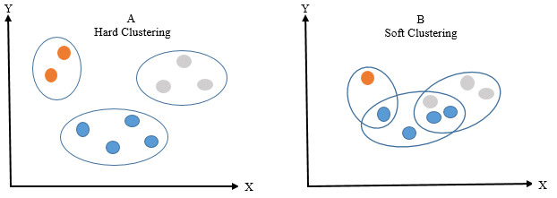
Hard vs Soft Clustering

Slide 2
Hard Clustering
Also known as Exclusive Clustering or Crisp Clustering.
Each data point is assigned to exactly one cluster.
Results in non-overlapping clusters with clear boundaries.
E.g., K-means or hierarchical clustering

Slide 3
Advantages
Simplicity and Ease of Implementation: Hard clustering algorithms are straightforward to understand and implement.
Computational Efficiency: Ideal for handling large datasets efficiently.
Clear Cluster Membership: Each data point unambiguously belongs to a single cluster.
Disadvantages
Sensitive to Initial Placement: Results can vary depending on the initial cluster centroids.
Limited Handling of Overlapping Data: May struggle with complex data structures that have overlapping clusters.
Impact of Outliers: Outliers can significantly affect cluster assignments.

Slide 4
Soft Clustering
Also known as Fuzzy Clustering.
Allows data points to belong to multiple clusters with varying membership degrees.
Provides more flexibility and captures uncertainty in cluster assignments.
E.g., Fuzzy C-means (FCM)

Slide 5
Advantages
Nuanced Cluster Assignments: Data points can have partial membership in multiple clusters, providing a more nuanced representation.
Handling Overlapping Data: Well-suited for datasets with complex or overlapping structures.
Robustness to outliers: The ability of a clustering algorithm to minimize the influence of outliers on the assignment of data points to clusters. (probability distribution over clusters instead of a hard assignment to a single cluster)
Disadvantages
Computational Complexity: Soft clustering methods can be more computationally expensive than their hard clustering counterparts.
Determining the Number of Clusters: Requires the pre-specification of the number of clusters or fuzziness coefficient.
Interpretability Challenges: Fuzzy memberships might be more challenging to interpret.

Slide 6
How to Find the Optimal Number of Clusters
The elbow method is a popular technique used to determine the optimal number of clusters (k) in a clustering algorithm, such as K-means.
It involves plotting the cost (inertia) of clustering as a function of the number of clusters and looking for the "elbow point" in the plot.
The elbow point is the value of k at which the inertia starts to level off or decrease at a slower rate.
This point indicates that adding more clusters does not significantly improve the clustering quality and suggests the appropriate number of clusters for the data.

Slide 7
Cont.
The elbow method helps us find the optimal number of clusters for our data.
It involves analyzing the inertia (within-cluster sum of squares) as a function of the number of clusters.

Slide 8
Elbow Method: Step by Step
Choose a range of k values to consider (e.g., 1 to 10).
For each k value, run the K-means algorithm with k clusters on the data.
Calculate the inertia (sum of squared distances within clusters) for each k.
Plot the inertia values against the corresponding k values.

Slide 9
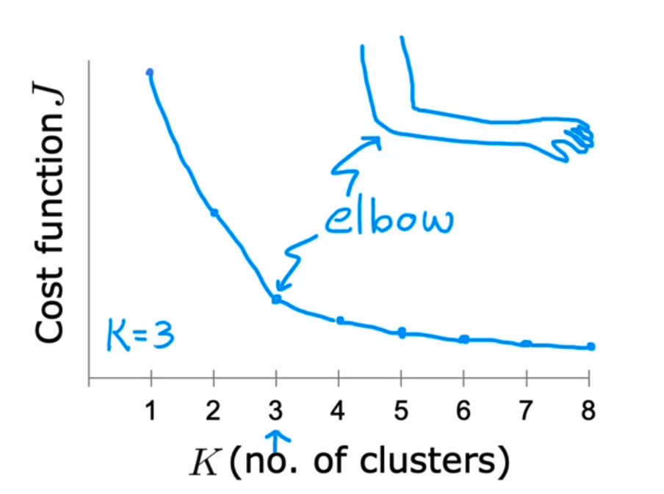
Cont.

Slide 10
Identifying the Elbow Point
The elbow point is the optimal k value.
It is the point where inertia starts to level off or decreases at a slower rate.
Adding more clusters beyond this point may not significantly improve clustering quality.

Slide 11
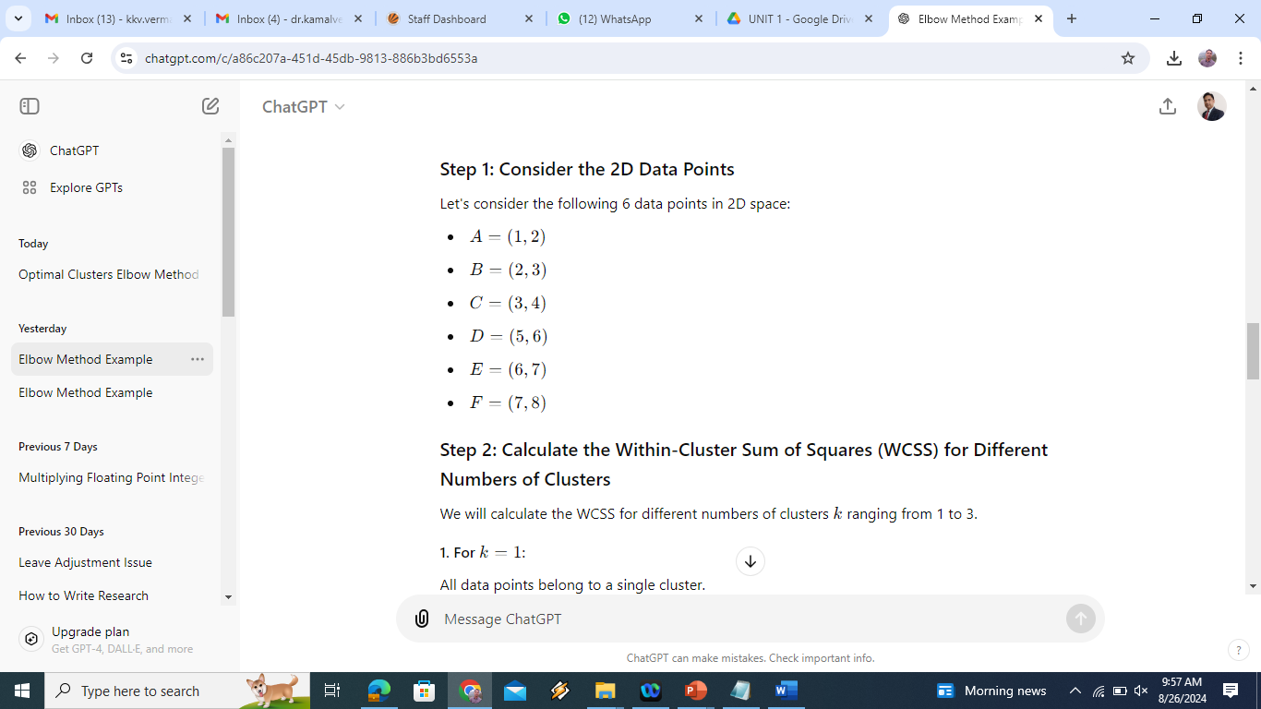
Example on elbow method

Slide 12
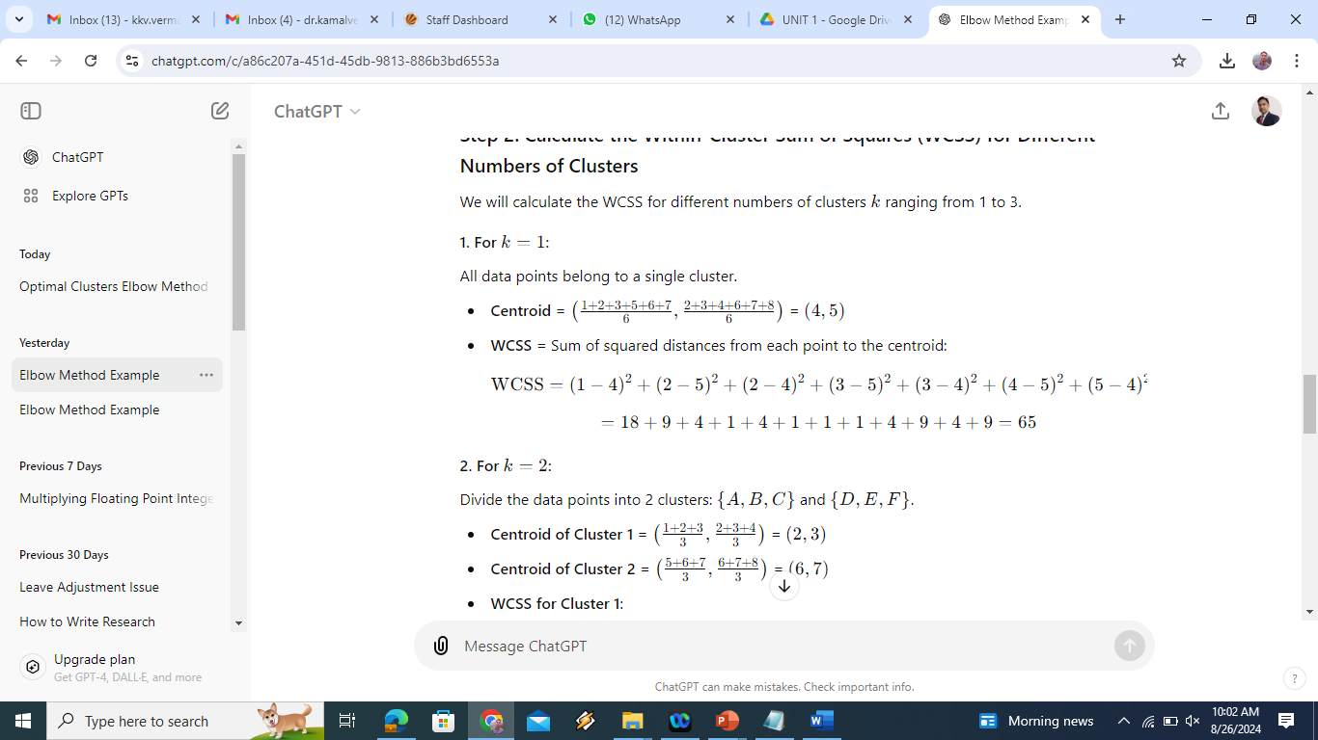

Slide 13
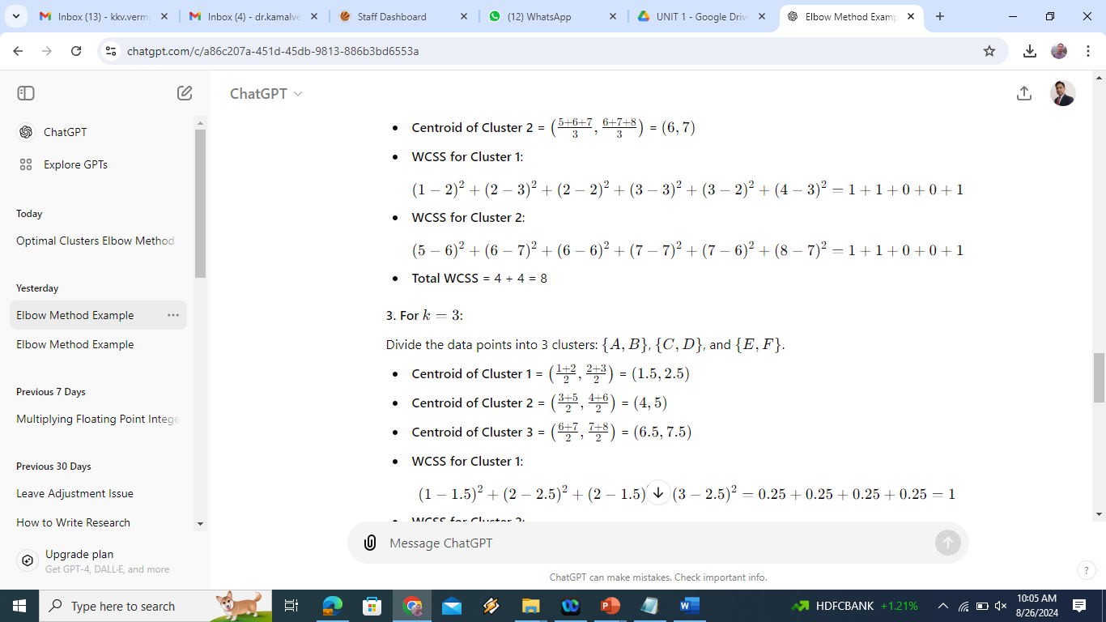

Slide 14
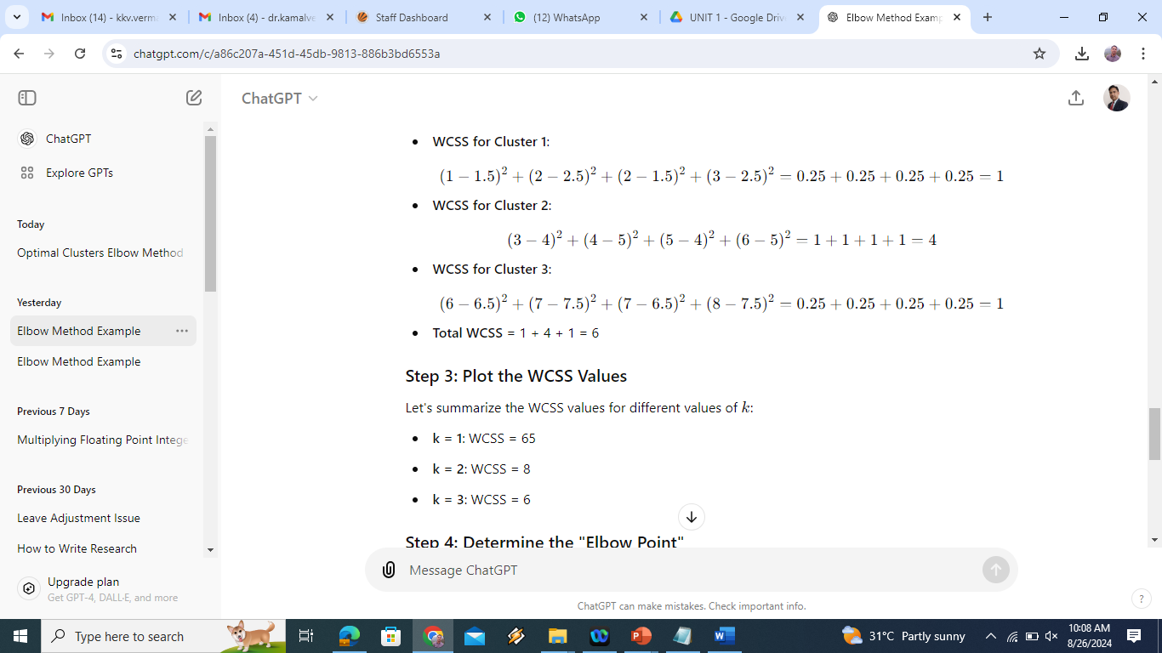
4. For K=4
Divide the data points into 4 clusters:
{(1,2), (2,3))}, {(3,4)} {(5,6)}, {(6,7), (7,8)}
Centroid of cluster 1: (1.5,2.5)
Centroid of cluster 2: (3, 4)
Centroid of cluster 3: (5,6)
Centroid of cluster 4: (6.5, 7.5)

Slide 15
4. For K=4
Divide the data points into 4 clusters:
{(1,2), (2,3))}, {(3,4)} {(5,6)}, {(6,7), (7,8)}
Centroid of cluster 1: (1.5,2.5)
Centroid of cluster 2: (3, 4)
Centroid of cluster 3: (5,6)
Centroid of cluster 4: (6.5, 7.5)

Slide 16
WCSS for cluster 1: (1-1.5)²+(2-2.5)²+(2-1.5)²+(3-2.5)²
= 1
WCSS for cluster 2: = (3-3)² + (4-4)²
= 0
WCSS for cluster 3: = (5-5)² + (6-6)²
= 0
WCSS for cluster 4: = (6-6.5)²+(7-7.5)²+(7-6.5)²+(8-7.5)² = 1
Total WCSS = 1+0+0+0 = 1
Similarly for k=5: WCSS will be=1
Step 3: Plot the WCSS Values
Let's summarize the WCSS values for different values of k:
For k=1: WCSS = 65 elbow point would be k =2.
For k=2: WCSS = 8
For k=3: WCSS = 6
For k=4: WCSS = 4
For k=5: WCSS = 1

Slide 17
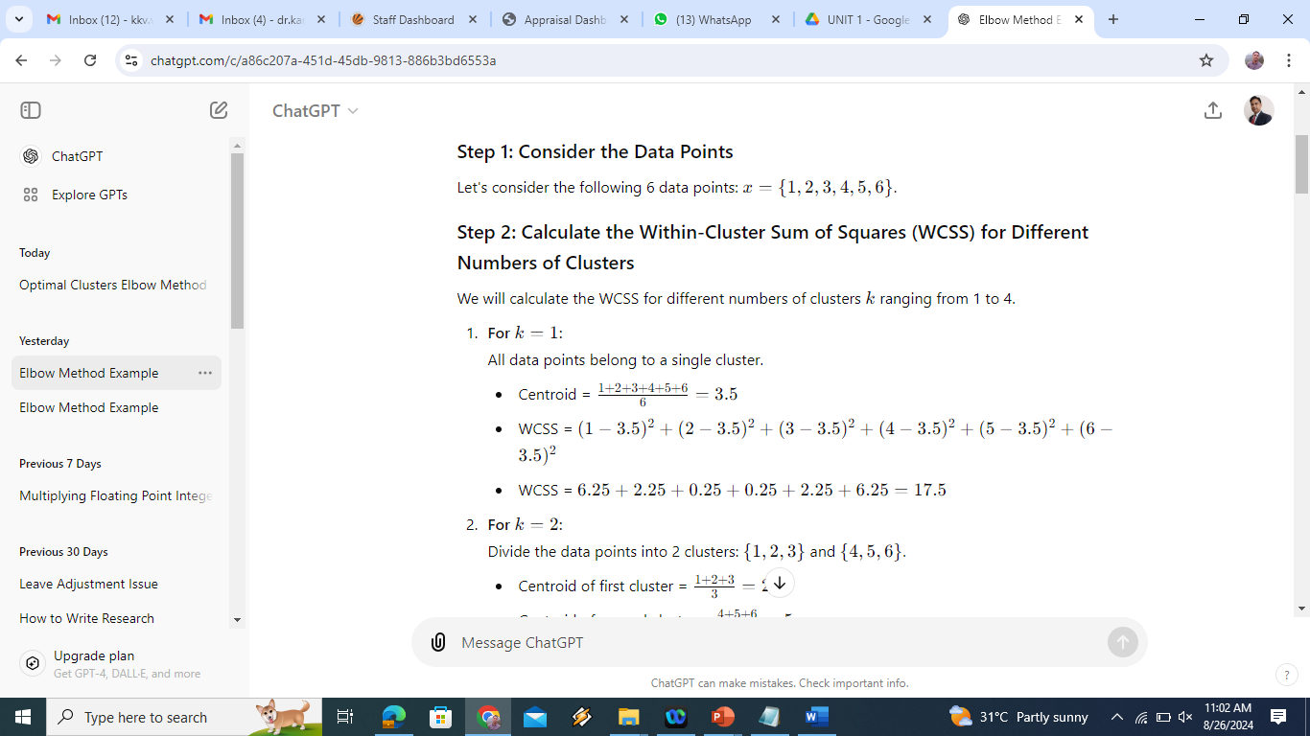

Slide 18
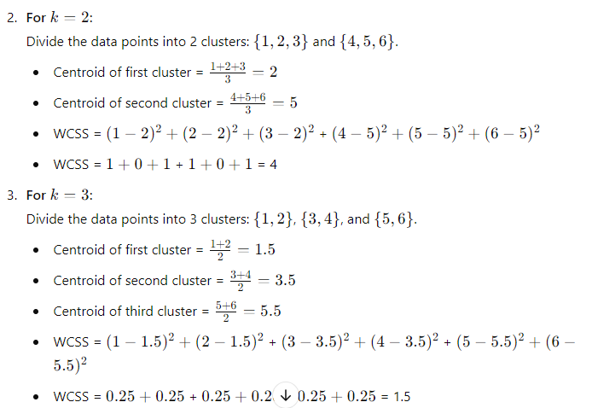

Slide 19
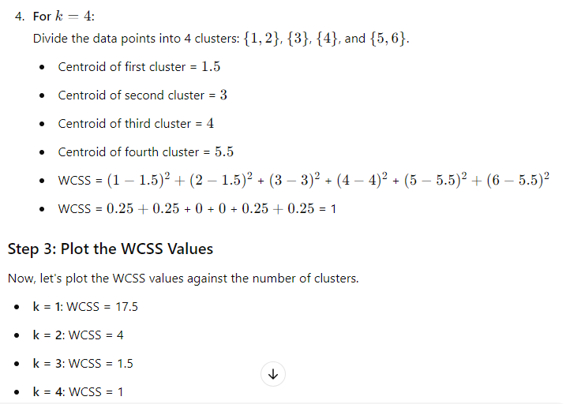

Slide 20
Step 4: Determine the "Elbow Point"
When you plot these values on a graph, the "elbow" is typically where the WCSS begins to level off. In this case, the significant drop occurs between k=1 and k=2, and then the decrease slows down significantly after k=3. Therefore, the optimal number of clusters could be k=2 or k=3.
Conclusion
Based on the elbow method, the optimal number of clusters for this dataset appears to be either 2 or 3, depending on how sharply you perceive the "elbow."
This method helps in identifying the most appropriate number of clusters to use in clustering algorithms such as K-means.

